Slide 1
News from the NHS –
Using policy to your advantage
Bronwen Thompson,
Policy adviser to PCRS-UK
June 8/9, 2018
RL workshop, Sheffield

Slide 2
STP
CCG
ACS
PAC
MCP
ACO
GP federations
ICS
Local authority

Slide 3
STP
CCG
ACS
My project
PAC
MSP
ACO
GP federations
ICS
Local authority

Slide 4
Overview
Understanding your environment will help you to make your project relevant
Find out what is important locally
Link to existing agendas
Tailor your project to local situation
Notes:
These are the key themes that will be covered in this presentation.
All team members need to take their share of leadership. Being a member of a team is not about passive following, or just doing your small bit. It is about shared leadership and cooperation and collaboration towards a shared goal. There may still be a ‘leader’ but good teamwork will be about every team member taking responsibility for the shared goals, not just their bit.
Key learning came from the 2 year long integrated care pilots led by DH and on which an evaluation report was published in 2013. Patients need all the different people involved in their care to be coordinating efforts around their needs. It is not so much about organisations being integrated as the individuals involved in their care sharing information and organising care around the patient, not around individual conditions they may have. Integrated care without good communication between parties is likely to fall short for the patient.
Teamwork may be ‘nice to have’ for healthcare staff, but patients rely on it. Healthcare staff can operate effectively by working in isolation – and ‘doing their bit’ but this won’t deliver for the patient. They need to be treated as an individual – possibly with a group of conditions or needs. Care which only focuses on a single condition is going to miss the point. Teamworking usually results in more professional satisfaction for the healthcare workers, as well as better outcomes for the patient.
If care is to live up to the maxim ‘No decision about me, without me’ – then it is the patient’s goals and life that should be the focus of care. A healthcare professional is not an expert in what an individual patient wants for their life. The patient is. They need to support and expertise of professionals in order to achieve those goals. So the patient is a core part of the healthcare team – and possibly their carer too. They are not an add-on. They must be central. Without their unique perspective, all the efforts of the healthcare team could be worth nothing.

Slide 5
What is important locally?
What are the local priorities?
What local data is available?
What sources would you go to?

Slide 6
Plans at different levels in NHS
44
STP areas
209
CCGs
Federations/
Clusters
Practices

Slide 7
Potential sources
CCGs
Annual report
Public Prospectus
Strategy and planning document
Joint strategic needs assessment
Joint health and wellbeing strategy
Commissioning Intention Plan on a page
Public health profiles
Director of public health report
Performance management framework ( Isle of Wight)
Quality and Performance framework (Tower Hamlets)
Collaborative commissioning agreement across several CCGs
Sustainability and Transformation Plans (STPs)

Slide 8
Local level respiratory data
Commissioning for value – Focus packs for CCGs from RightCare
INHALE - database of respiratory information at local level (2013/14)
Compare your care – AsthmaUK – regional level (2015)
Public health in local authorities
Pharmaceutical adviser
Local audits
National COPD audit – hospital level data
Academic health science network?
Others?

Slide 9
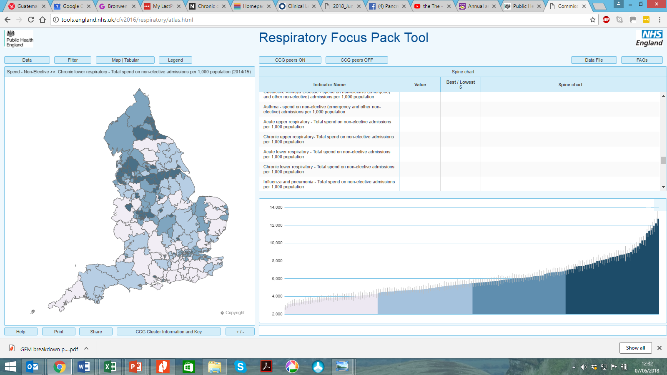

Slide 10
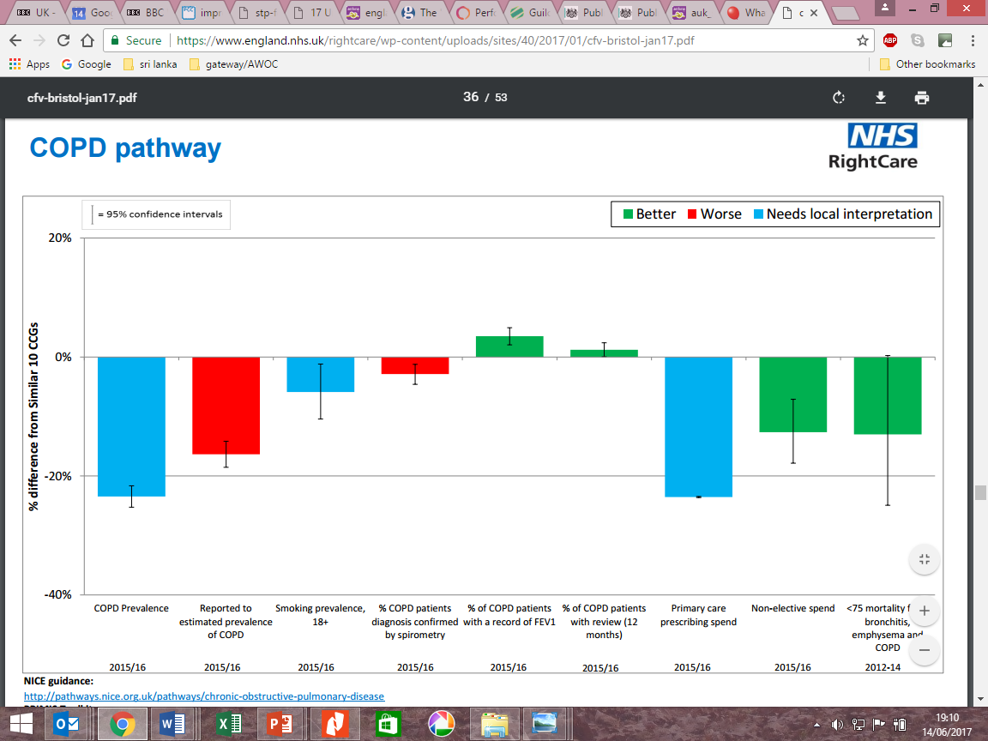

Slide 11
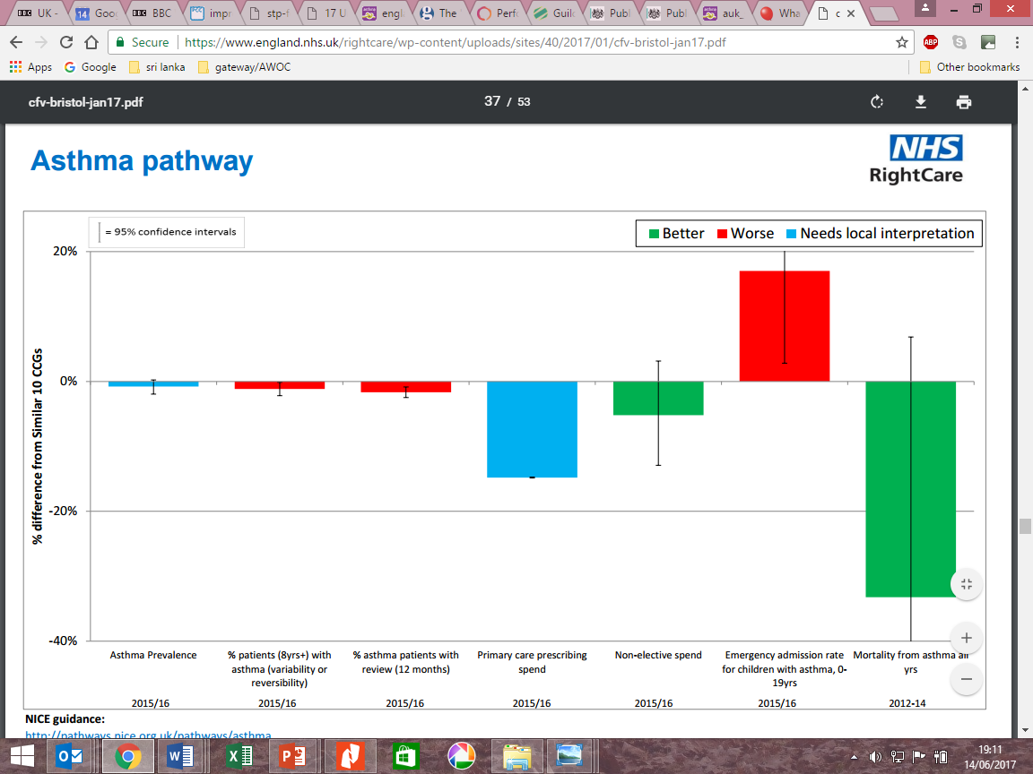

Slide 12
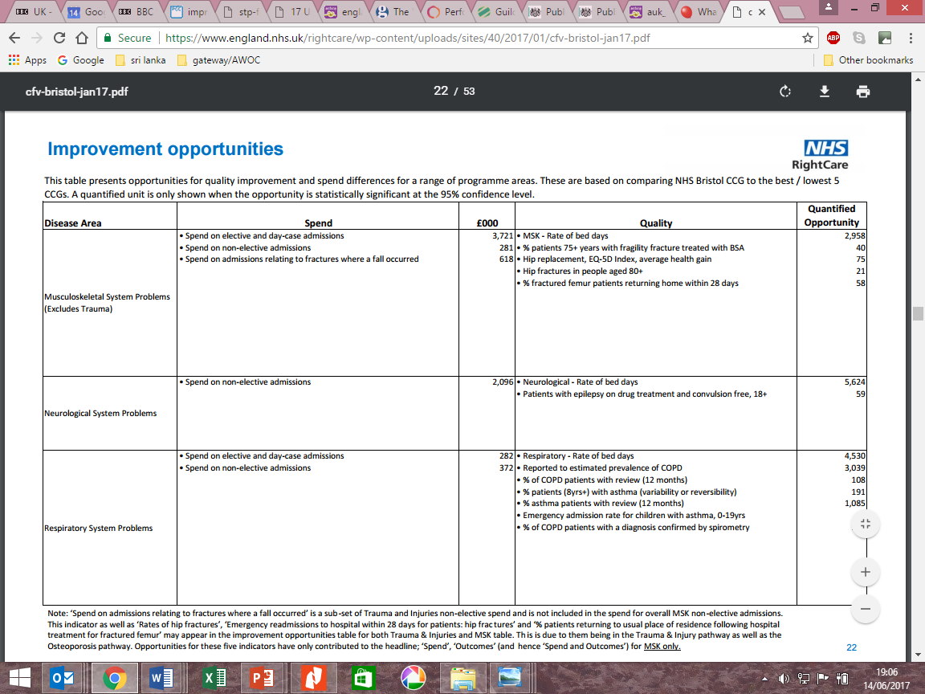
https://www.england.nhs.uk/rightcare/wp-content/uploads/sites/40/2017/01/cfv-bristol-jan17.pdf

Slide 13
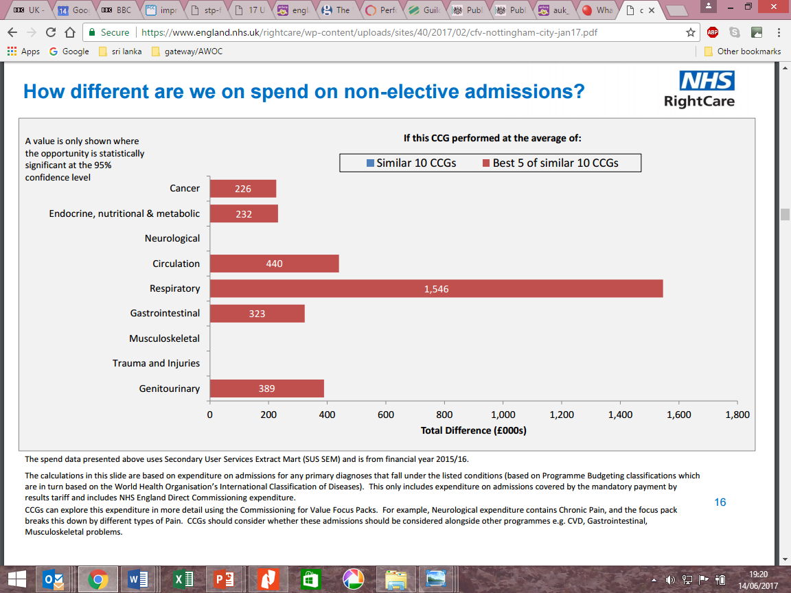

Slide 14
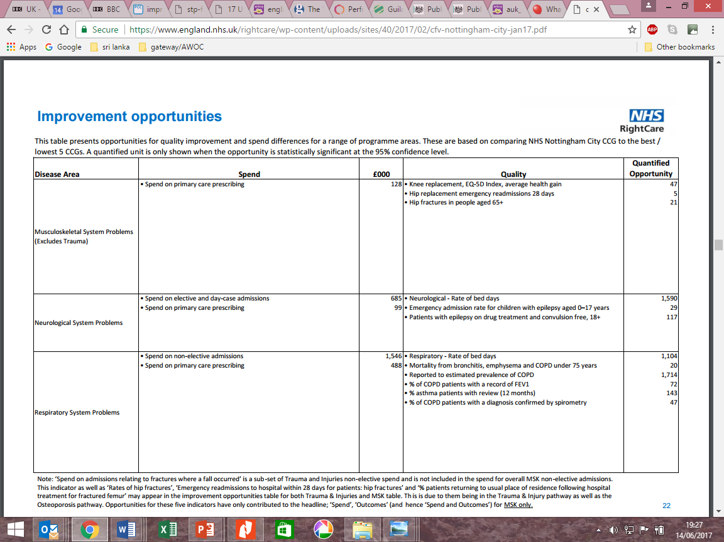

Slide 16
Local level respiratory data
Commissioning for value – Focus packs for CCGs from RightCare
INHALE - database of respiratory information at local level (2013/14)
Compare your care – AsthmaUK – regional level (2015)
Public health in local authorities
Pharmaceutical adviser
Local audits
National COPD audit – hospital level data
Academic health science network?
Others?

Slide 17
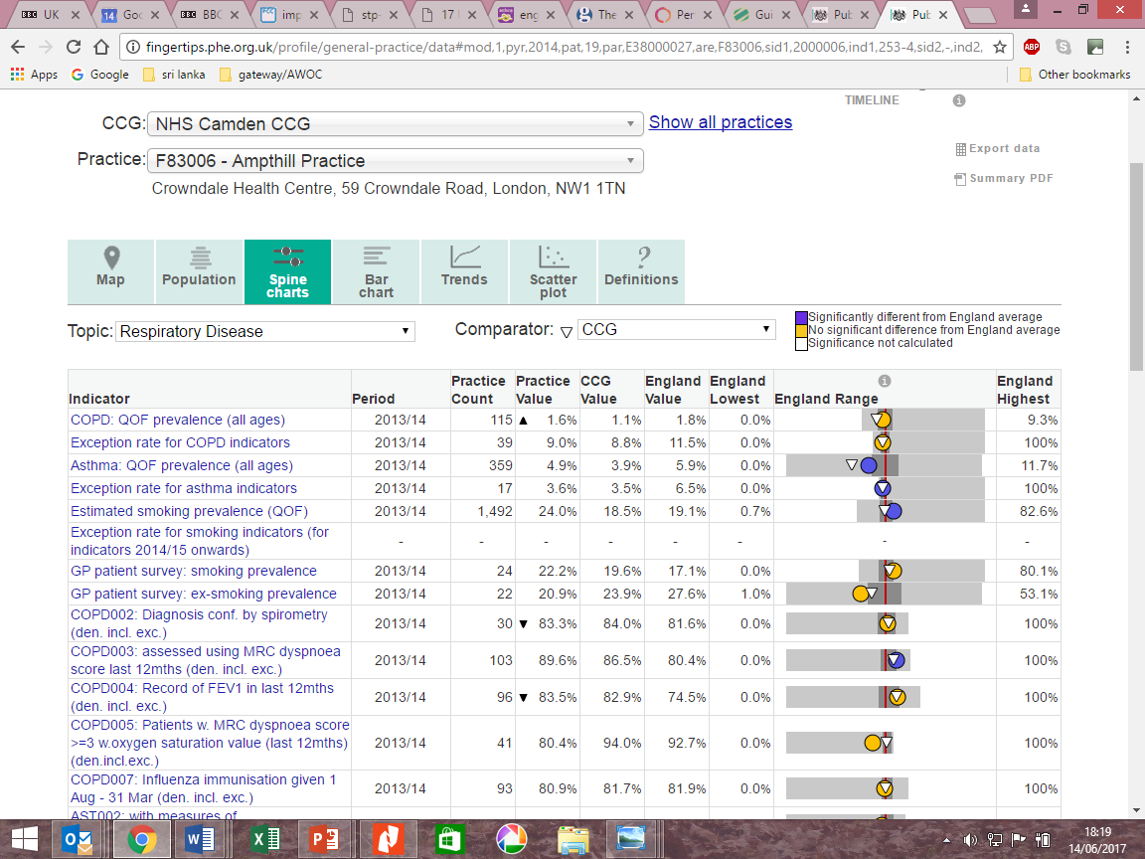

Slide 18
Local level respiratory data
Commissioning for value – Focus packs for CCGs from RightCare
INHALE - database of respiratory information at local level (2013/14)
Compare your care – AsthmaUK – regional level (2015)
Public health in local authorities
Pharmaceutical adviser
Local audits
National COPD audit – hospital level data
Academic health science network?
Others?

Slide 19
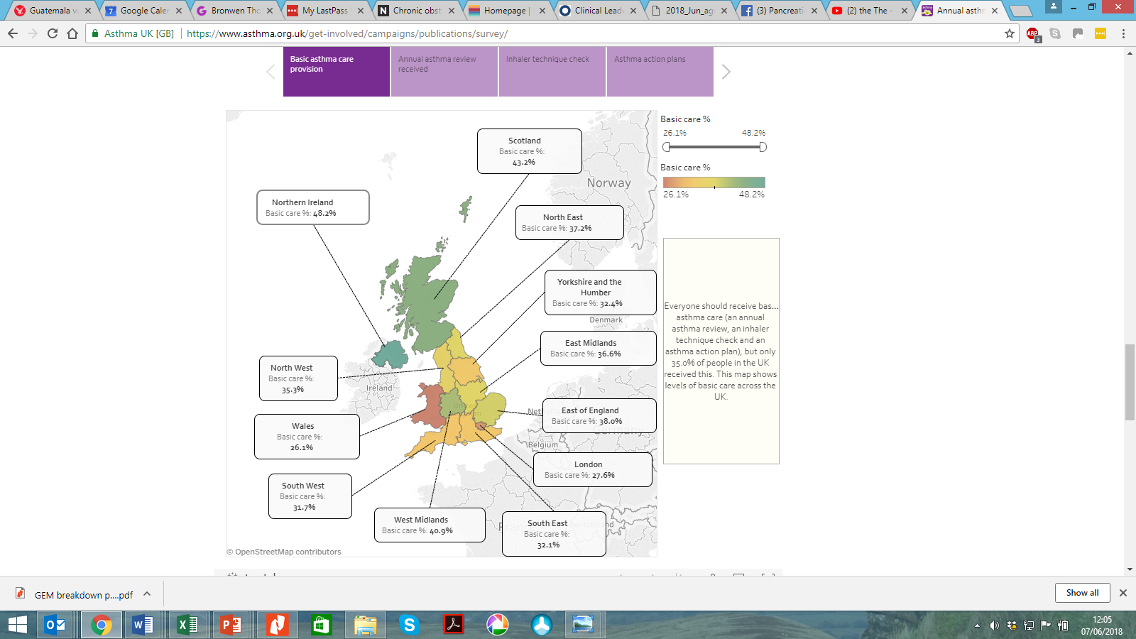

Slide 20
What are the data sources nationally?
NICE/ BTS/SIGN guidelines
NICE/BTS Quality standards
National reports:
All party parliamentary group report into respiratory deaths (June 2014)
National Review of Asthma Deaths (May 2014)
The Battle for Breath - BLF
~~~~~~~~~~~~~~~~~~~~~~~~~~~~~~~~
NHS outcomes framework / Public health outcomes framework
National COPD audit
Respiratory Atlas of Variation
NHS RightCare COPD pathway
Compare your care - AsthmaUK

Slide 21
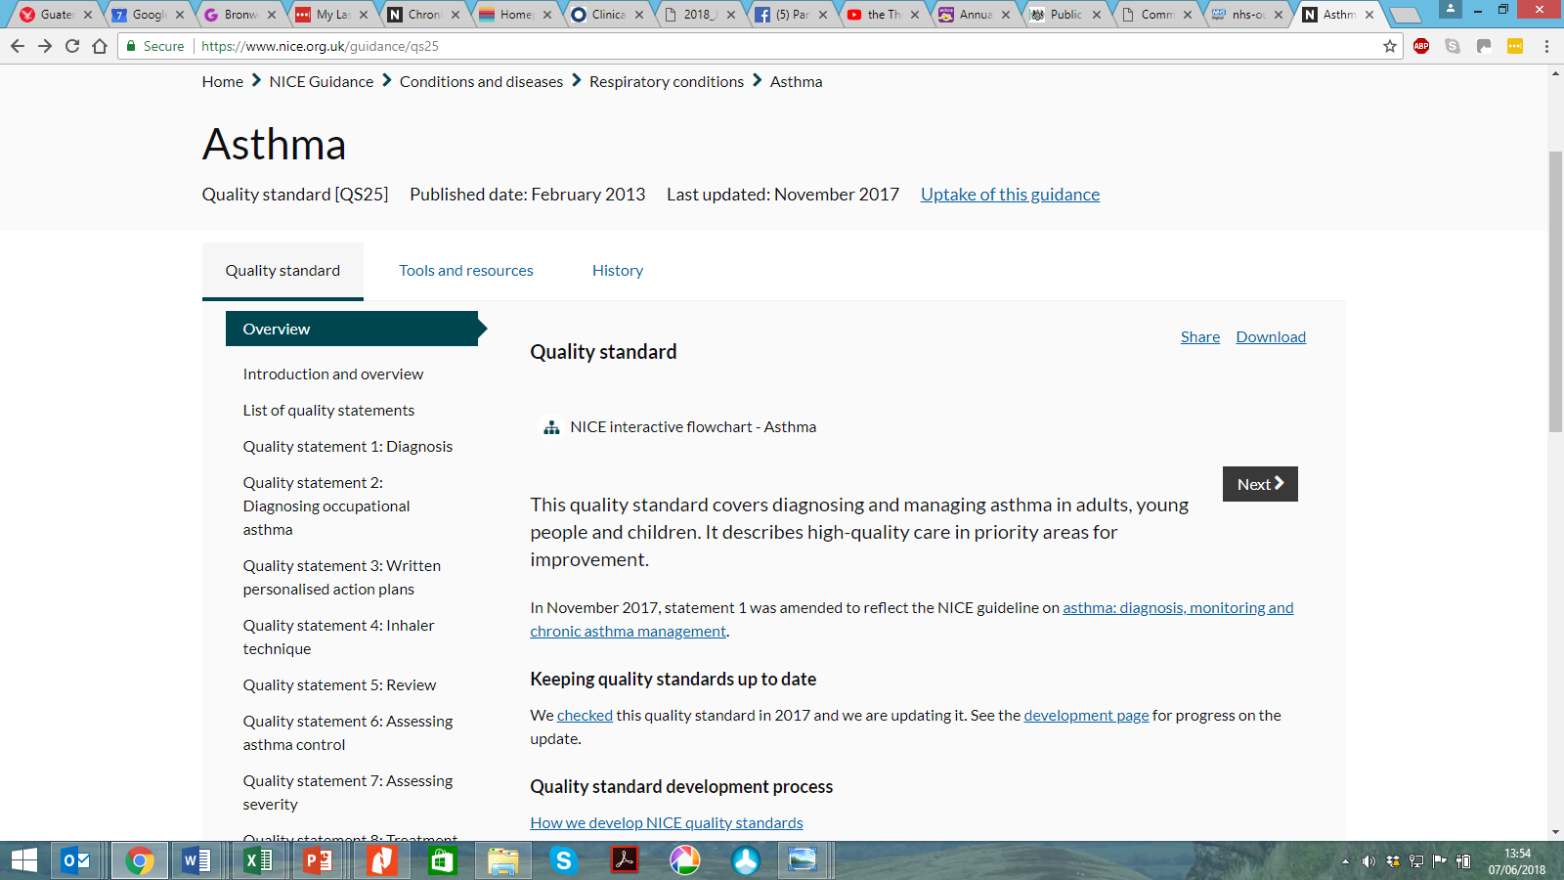
NICE asthma quality standard – Evidence of uptake

Slide 22
NICE asthma quality standard – Evidence of uptake
Statement: 3
People with asthma receive a written personalised action plan.
Quality standard measure: Proportion of people with asthma who receive a written personalised action plan.
What was measured: Proportion of people with asthma who subsequently died with a record of being provided with a personal asthma action plan in either primary or secondary care.
Data collection end: January 2013 23%
23%
Number that met the criteria: 44 / 195
Area covered: | National
Source: | Health and Social Care Information Centre. Quality and Outcomes Framework.
Area covered: | UK
Source: | Royal College of Physicians. Why asthma still kills: The National Review of Asthma Deaths (NRAD).

Slide 23
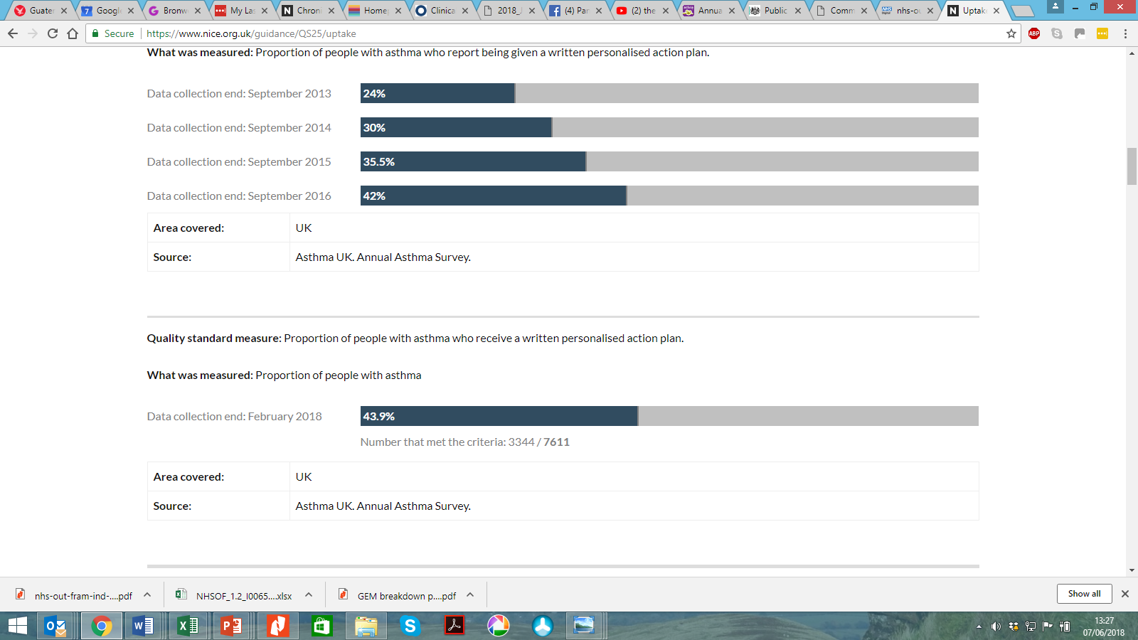
NICE asthma quality standard – Evidence of uptake

Slide 24
What are the data sources nationally?
NICE/ BTS/SIGN guidelines
NICE/BTS Quality standards
National reports:
All party parliamentary group report into respiratory deaths (June 2014)
National Review of Asthma Deaths (May 2014)
The Battle for Breath - BLF
~~~~~~~~~~~~~~~~~~~~~~~~~~~~~~~~
NHS outcomes framework / Public health outcomes framework
National COPD audit
Respiratory Atlas of Variation
NHS Rightcare COPD pathway
Compare your care - AsthmaUK

Slide 25
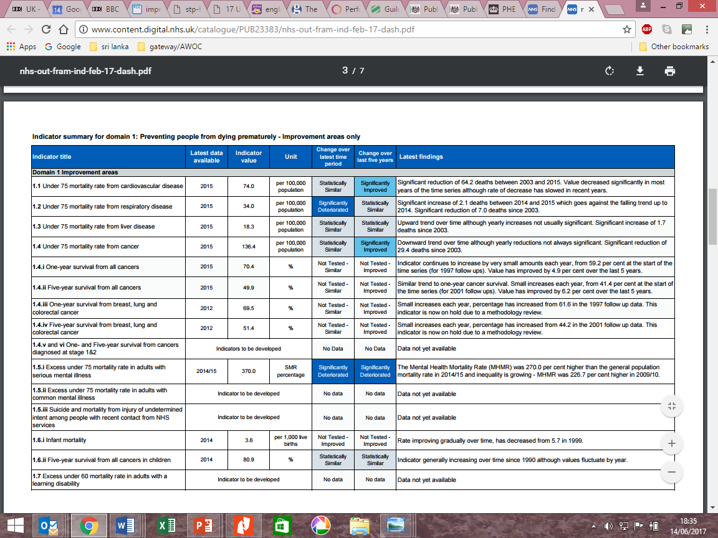
Under 75 mortality from respiratory disease - 2017

Slide 26
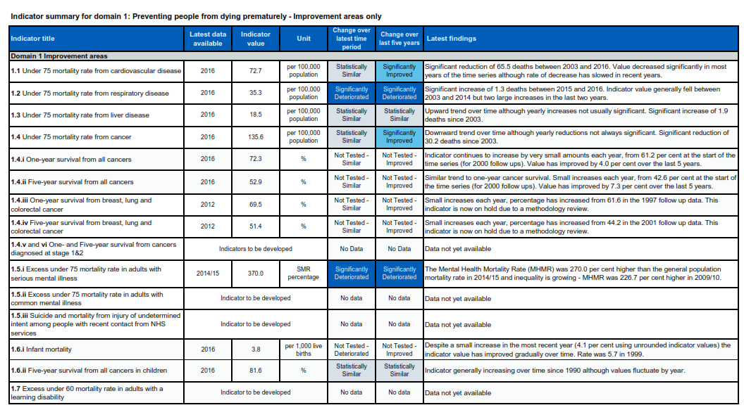
Under 75 mortality from respiratory disease - 2018

Slide 27
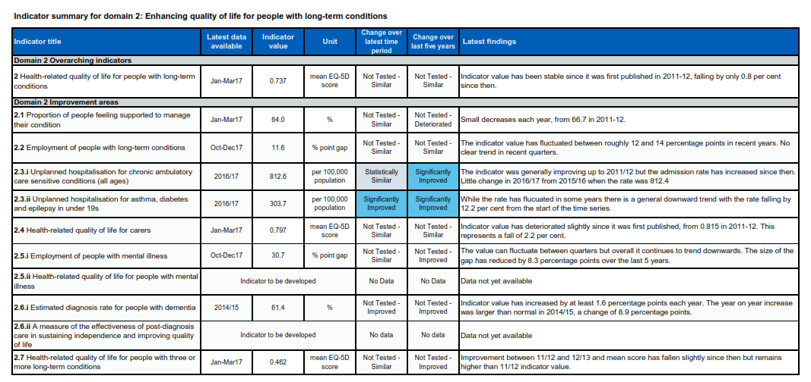
Unplanned admissions in under 19s – incl asthma - 2018

Slide 28
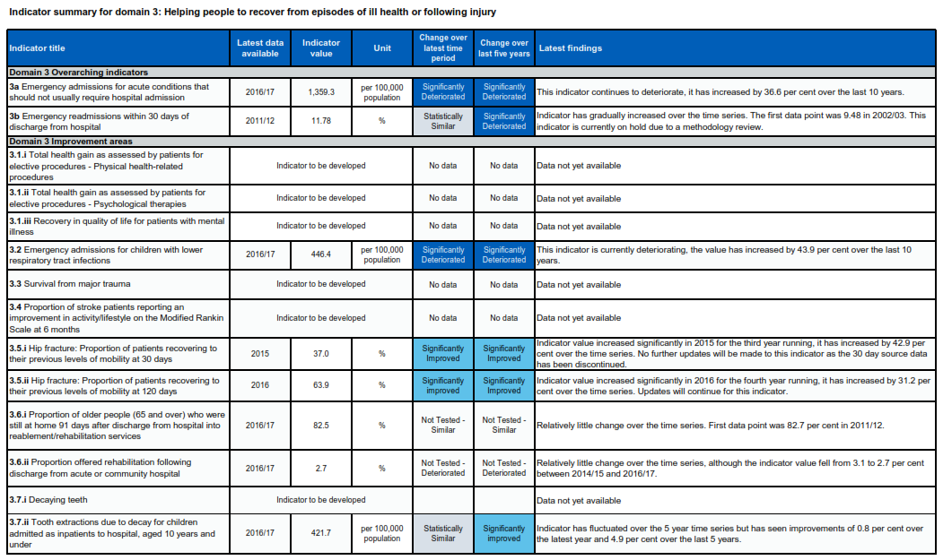
Emergency admissions – children with LRTI - 2018

Slide 29
What is important nationally?
You are correct and these things ebb and flow. It is the consequence of the NHS having no need for data when there is no priority. However,
The Atlas of Respiratory Variation is being revised with a publication date in the autumn
GIRFT will come up with data in the autumn
The BLF Task force will also be helpful
RightCare stuff is variable especially around specialised commissioning
If we are successful with a programme then we will get some on-going analytical support, so fingers crossed.
Professor Mike Morgan, National clinical director for respiratory
NHS outcomes framework / Public health outcomes framework
CCG improvement and assessment framework (CCG IAF)
NICE/ BTS/SIGN guidelines
NICE/BTS Quality standards
National COPD audit
Best practice tariff - COPD
The Battle for Breath - BLF
Respiratory Atlas of Variation
Compare your care - AsthmaUK
National reports:
All party parliamentary group report into asthma deaths (June 2014)
National Review of Asthma Deaths (May 2014)

Slide 31
What are the data sources nationally?
NICE/ BTS/SIGN guidelines
NICE/BTS Quality standards
National reports:
All party parliamentary group report into respiratory deaths (June 2014)
National Review of Asthma Deaths (May 2014)
The Battle for Breath - BLF
~~~~~~~~~~~~~~~~~~~~~~~~~~~~~~~~
NHS outcomes framework / Public health outcomes framework
National COPD audit
Respiratory Atlas of Variation
NHS RightCare COPD pathway
Compare your care - AsthmaUK

Slide 32
Diagnosis data – from National COPD audit in primary care

Slide 33
Deprivation data – from National COPD audit in primary care

Slide 34
Co-morbidity data – from National COPD audit in primary care

Slide 35
What are the data sources nationally?
NICE/ BTS/SIGN guidelines
NICE/BTS Quality standards
National reports:
All party parliamentary group report into respiratory deaths (June 2014)
National Review of Asthma Deaths (May 2014)
The Battle for Breath - BLF
~~~~~~~~~~~~~~~~~~~~~~~~~~~~~~~~
NHS outcomes framework / Public health outcomes framework
National COPD audit
Respiratory Atlas of Variation
NHS RightCare COPD pathway
Compare your care - AsthmaUK

Slide 38
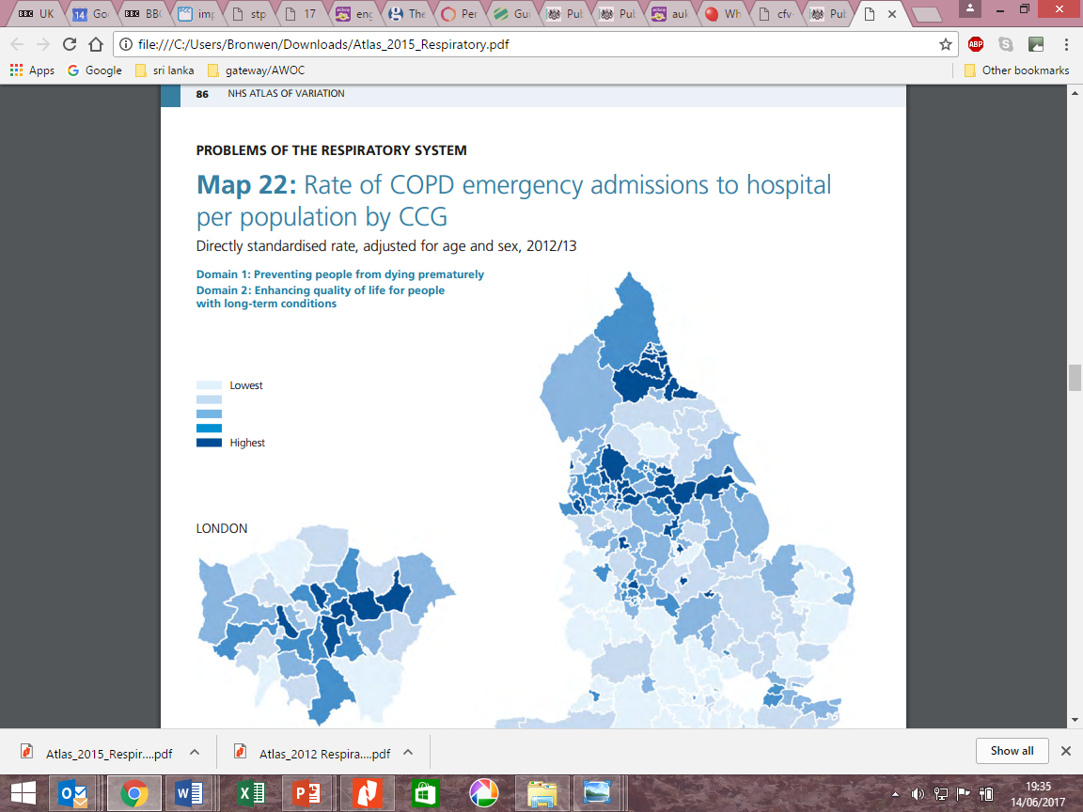
NHS Atlas of variation - respiratory (RightCare) 2015

Slide 39
Be clever with numbers
1000 people a year in England die from asthma
10-12% of children have asthma
3 people die from asthma every day
1 person dies every 8 hours
In every classroom there may be 3-4 children with asthma
In a school of 1000 children, there may be 100 children with asthma

Slide 40
Be clever with numbers
There are 94,000 admissions a year for COPD every year
65,000 people a year are hospitalised for asthma
Since you left home yesterday, there will have been 200 admissions for people with COPD
And by the time you leave here tomorrow, there will have been 450 admissions across the country
In the UK, someone is hospitalised every 8 minutes.

Slide 41
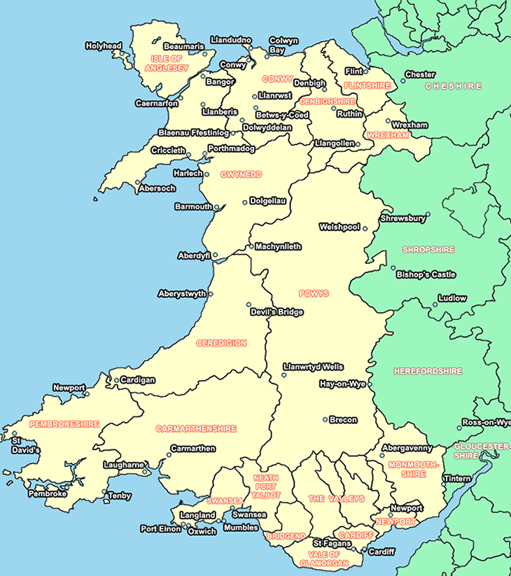
Tailor information to local situation
Base numbers on 3 million population vs 66 million in UK
Highlight health data for Wales
Highlight health data for Healthboards

Slide 42
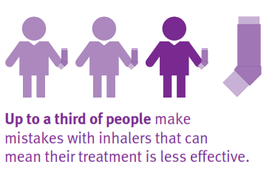
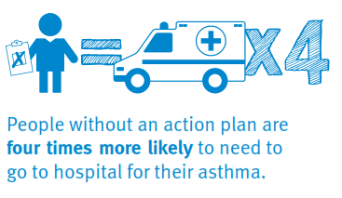
The power of a good visual

Slide 43
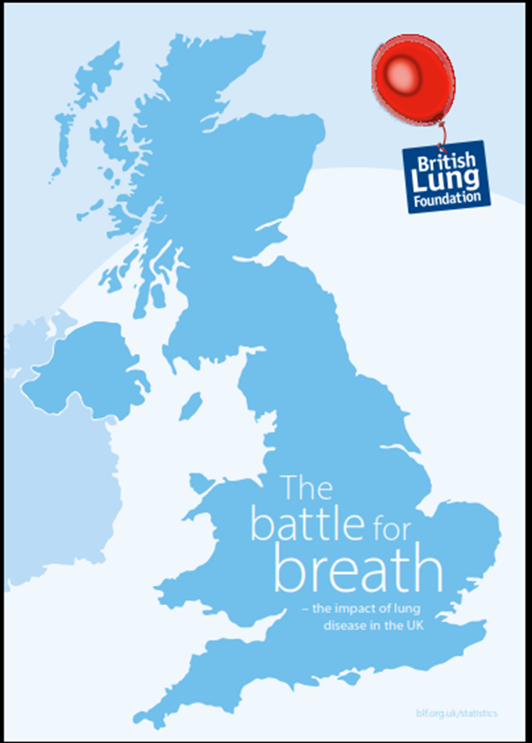
Make comparisons with priorities on the local agenda
Key findings
Lung disease is one of the top three killer diseases in the UK
115,000 people a year die from lung disease - 1 person every 5 minutes
Mortality figures are roughly the same as 10 years ago, yet heart disease has fallen 15%
1 in 5 people in the UK have been diagnosed with a lung disease
Every day, 1,500 new people are diagnosed with a lung disease

Slide 44
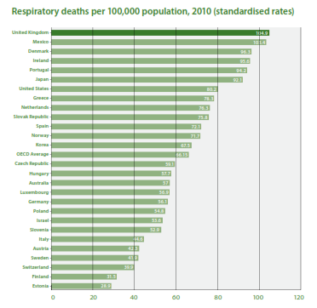

Slide 45
Tell a story
People with COPD and MRC score of <=3 should be referred to PR programme
No. people in CCG likely to need PR
Current levels of PR provision in CCG

Slide 46
Tell a story
NHS outcomes framework
Priority to reduce premature deaths from respiratory disease

Slide 47
In conclusion…..
Understanding your environment will help you to make your project relevant
Find out what is important locally
Link to existing agendas
Tailor your project to local situation
Notes:
These are the key themes that will be covered in this presentation.
All team members need to take their share of leadership. Being a member of a team is not about passive following, or just doing your small bit. It is about shared leadership and cooperation and collaboration towards a shared goal. There may still be a ‘leader’ but good teamwork will be about every team member taking responsibility for the shared goals, not just their bit.
Key learning came from the 2 year long integrated care pilots led by DH and on which an evaluation report was published in 2013. Patients need all the different people involved in their care to be coordinating efforts around their needs. It is not so much about organisations being integrated as the individuals involved in their care sharing information and organising care around the patient, not around individual conditions they may have. Integrated care without good communication between parties is likely to fall short for the patient.
Teamwork may be ‘nice to have’ for healthcare staff, but patients rely on it. Healthcare staff can operate effectively by working in isolation – and ‘doing their bit’ but this won’t deliver for the patient. They need to be treated as an individual – possibly with a group of conditions or needs. Care which only focuses on a single condition is going to miss the point. Teamworking usually results in more professional satisfaction for the healthcare workers, as well as better outcomes for the patient.
If care is to live up to the maxim ‘No decision about me, without me’ – then it is the patient’s goals and life that should be the focus of care. A healthcare professional is not an expert in what an individual patient wants for their life. The patient is. They need to support and expertise of professionals in order to achieve those goals. So the patient is a core part of the healthcare team – and possibly their carer too. They are not an add-on. They must be central. Without their unique perspective, all the efforts of the healthcare team could be worth nothing.

Slide 48
STP
CCG
ACS
My project
PAC
MSP
ACO
GP federations
ICS
Local authority

Slide 49
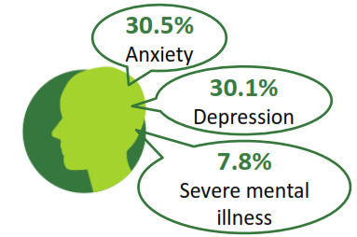
National priorities
International comparisons
National data
National reports
Local plans
Local data
Local priorities
Make comparisons
Clever with numbers
Telling a story
My project

