Slide 1
Controlling the Monkey Mind
Melissa Canavan

Slide 2
What is the mind?

Slide 3
Mind
Not the brain
Not physical
Beginning less and endless
Mental Continuum
River of mental moments
Constantly Changing

Slide 4
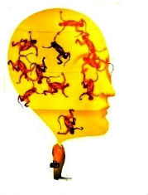
Monkey Mind

Slide 10
